Slide 1

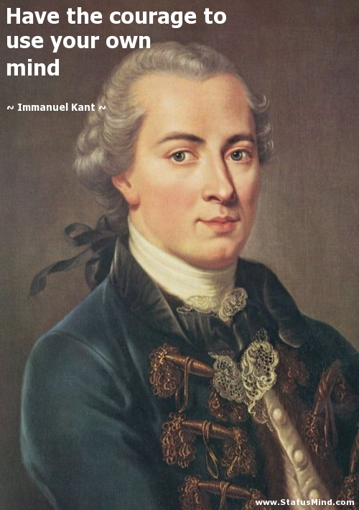

As I’m sure you realise by now RMPS is all about thinking deeply and having your own opinions, then trying to articulate them.
A good RMPS student is opinionated! So get ready to give your opinion!

Slide 2

Would you rather
Hair
Teeth
Always have perfect hair or always have perfect teeth?

Slide 3


Would you rather
Be the richest person in the world with no friends or the poorest person in the world with lots of friends?
Rich + Lonely
Poor with friends

Slide 4

Would you rather
Go way back in time and meet your ancestors or go into the future and meet your great grandchildren.
Go back
Go to the future

Slide 5
Would you rather
Christmas
Birthday
Would you rather skip Christmas for a year, or skip your birthday for a year?

Slide 6
Would you rather
Fly
Read minds
Be able to fly or read minds

Slide 7


Course content
Morality and justice
Purposes of punishment
reformation
retribution
protection
deterrence
Responses to crime
custodial sentences
non-custodial sentences
capital punishment
Religious and non religious views on these issues

Slide 8
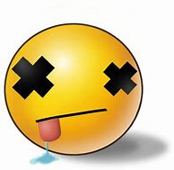
Learning Intentions: Today we are learning about Capital punishment
Success Criteria: By the end of the lesson you will be able to:
. Explain what capital punishment is
. Understand the status of CP around the world
. Have considered your views on this issue by looking at the arguments both for and against it.

Slide 9
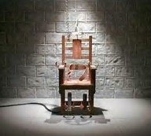
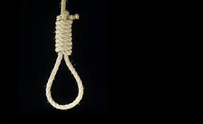
7.3.23 Capital Punishment
Definition: Capital punishment, also known as the death penalty, is the execution of a person by the state as punishment for a crime.
Crimes that can result in a death penalty are
known as capital crimes or capital offences.
The form of CP used varies from country to country.

Slide 10
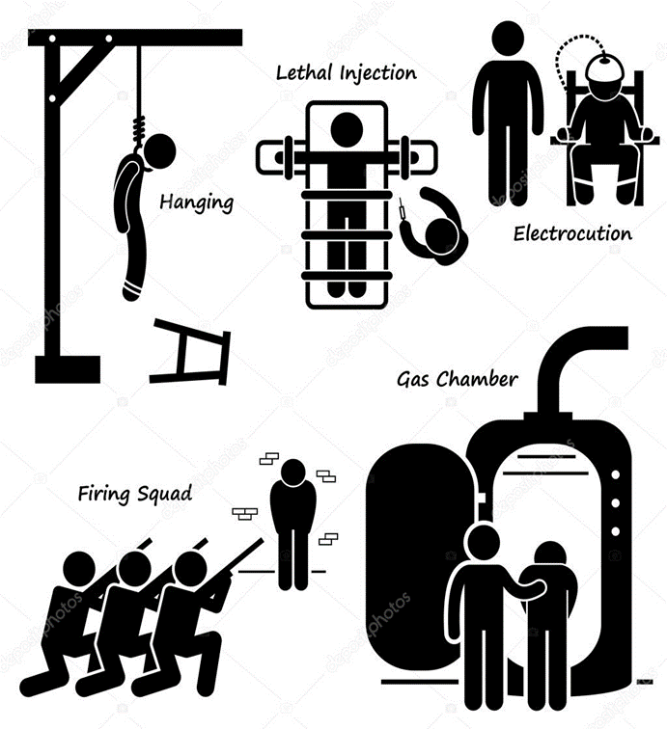
Methods of Execution
Stoning
Hanging
Electrocution
Lethal Injection
Gas Chamber
Shooting
Beheading
Add three to your notes.

Slide 11
The History of CP
The death penalty was abolished in England, Scotland and Wales in 1965 and in Northern Ireland in 1973.
Parliament still debates whether to bring back the death penalty, it has been debated 14 times since 1965
When Parliament votes on this subject MP’s don’t have to follow a Party line but can have a free vote to express their views and the views of the people they represent.

Slide 12
CP around the World
Today 53 countries still retain the death penalty.
Lets examine some of the statistics together.

Slide 13
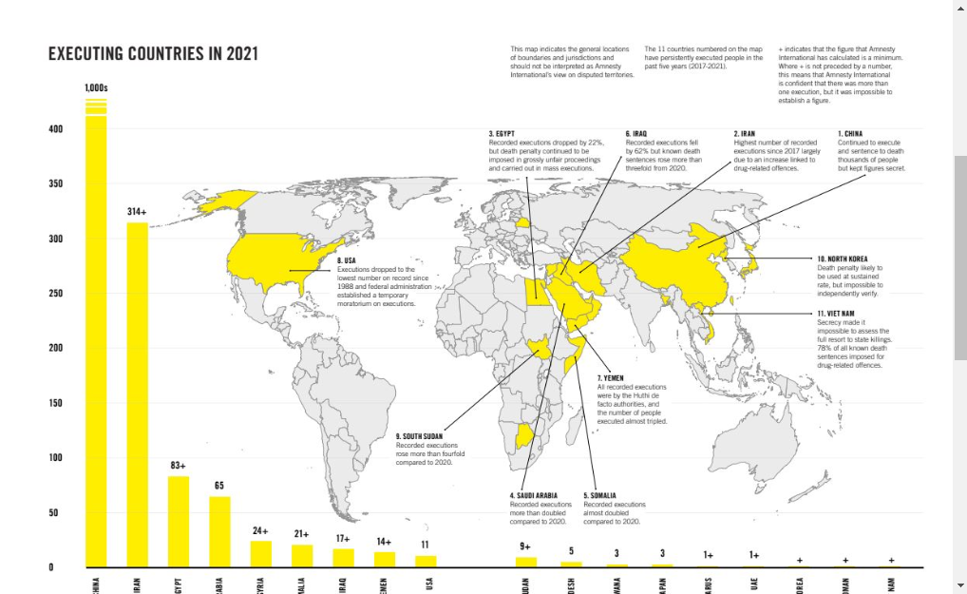

Slide 14
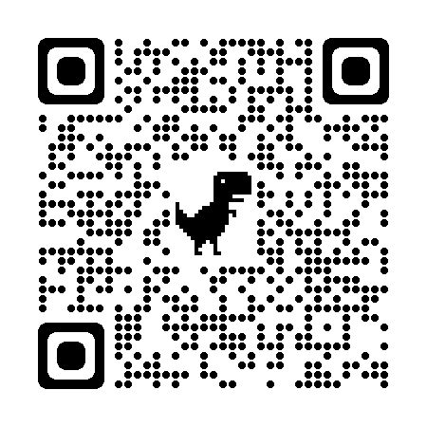
https://www.amnesty.org.uk/death-penalty-report-2021-0

Slide 15
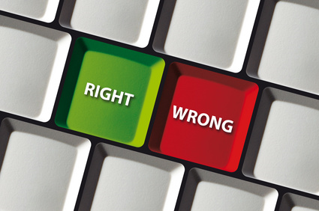
Capital Punishment is a complicated moral issue.
At the moment what do you think, is capital punishment right or wrong?

Slide 16
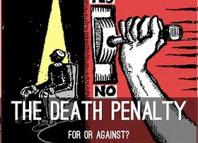
https://www.youtube.com/watch?v=_5aodBfdFTA
Watch this YouTube clip taken from question time a few years ago and discuss what are the main arguments for and against CP?

Slide 17
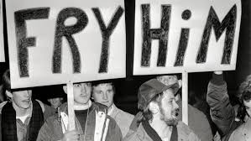
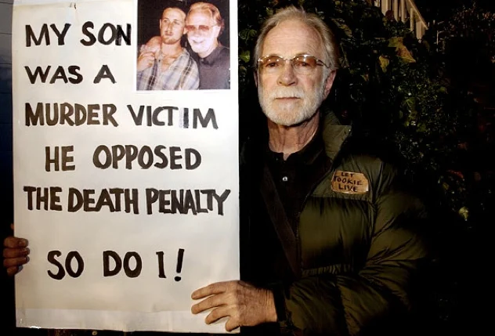
For Against
Lets examine the main arguments for and against CP

Slide 18
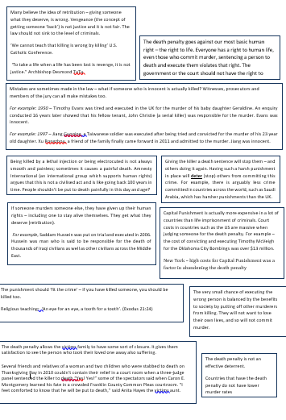
Cut of the arguments for and against and then rank them.

Slide 19
http://www.bbc.co.uk/ethics/capitalpunishment/against_1.shtml Against
http://www.bbc.co.uk/ethics/capitalpunishment/for_1.shtml
For
Value of human life
Right to live
Execution of the innocent
Retribution is wrong
Failure to deter
Brutalising society
Expense
People not responsible for their acts
Applied unfairly
Cruel, inhumane, degrading
Unnecessary
Free will
Retribution
Deterrence
Rehabilitation
Prevention of re-offending
Closure and vindication
Incentive to help police
A Japanese argument
Read through the different arguments and choose 3 for each that you find the easiest to understand.
Summarise it into two or three sentences.

Slide 20
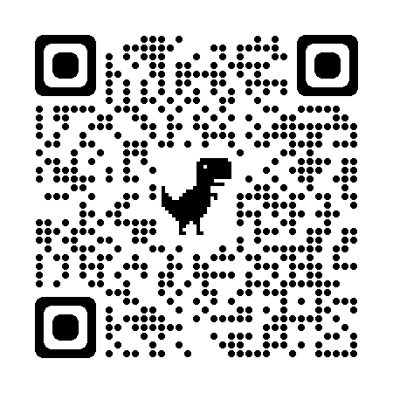
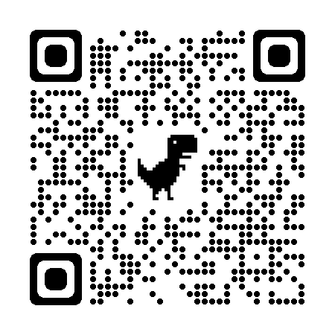
http://www.bbc.co.uk/ethics/capitalpunishment/for_1.shtml
For
http://www.bbc.co.uk/ethics/capitalpunishment/against_1.shtml Against

Slide 21
Written task: Argument For & Against
Using the arguments that you have learnt about answer the following questions....
1) Which argument do you most agree with? Why?
2) Which argument do you least agree with? Why?

